Slide 1
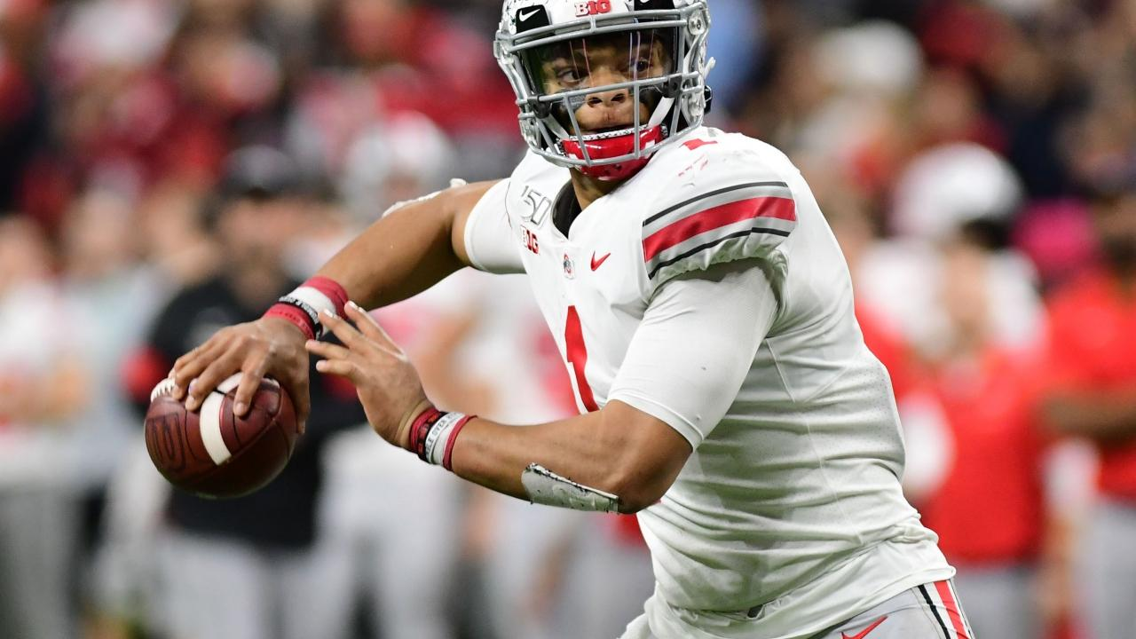
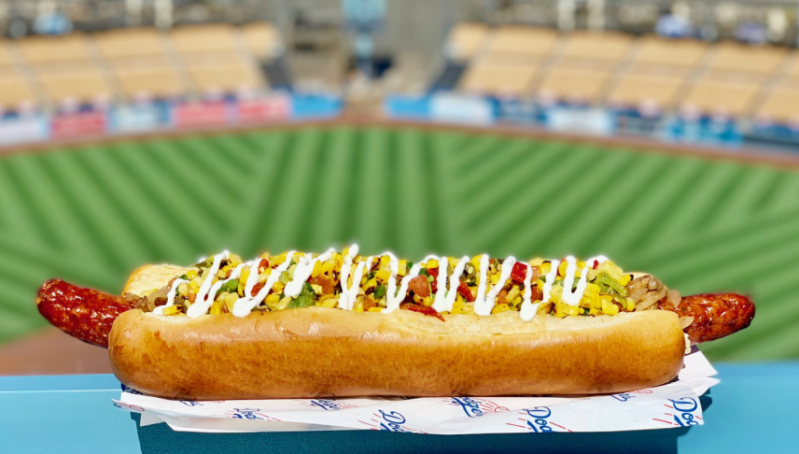
Gameday Atmosphere: Feeding the Masses
John Draper

Slide 2

Introduction/Business Problem
Opportunity to move our restaurant business to Columbus
How can will ‘fill a need’?
What is it the Buckeye fans crave on gameday, but can’t find near the stadium?

Slide 3
Data
All 120 college football stadiums will be scraped from Wikipedia
Includes city, state, conference, capacity
Geocode with geocoder package to get latitude/longitude
Join with population data from OpenDataSoft
Utilize the Foursquare API to find nearby venues to the stadiums and learn where the gaps exists based on similar schools
But how do we find similar schools?

Slide 4
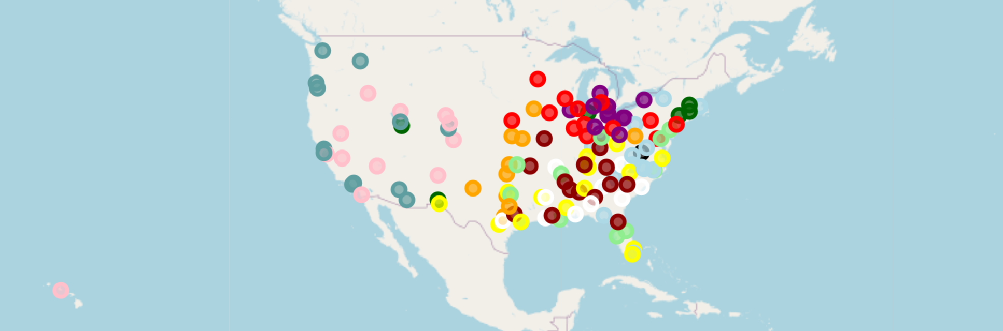
Preliminary map
All stadiums color coded by conference affiliation
Primarily determined geographically

Slide 5
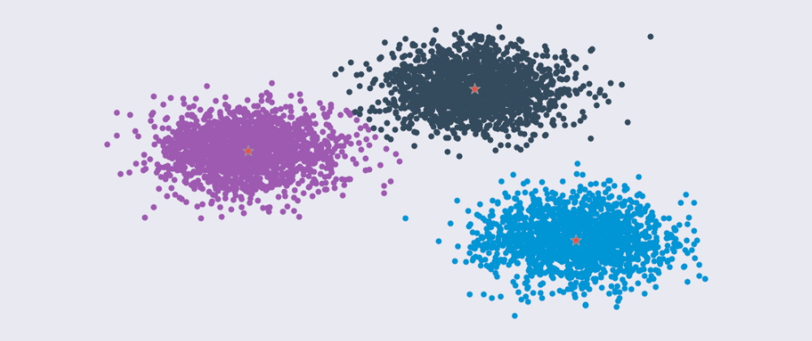
Methodology
After compiling the data, a kmeans clustering algorithm determined 5 clusters of tastes, city type, and stadium capacity.
5 was determined after a preliminary analysis didn’t yield a clear and obvious elbow
These clusters can be labeled using a deeper dive into the data of the clusters
OSU will be compared to its peer institutions (similar size and tastes)

Slide 6
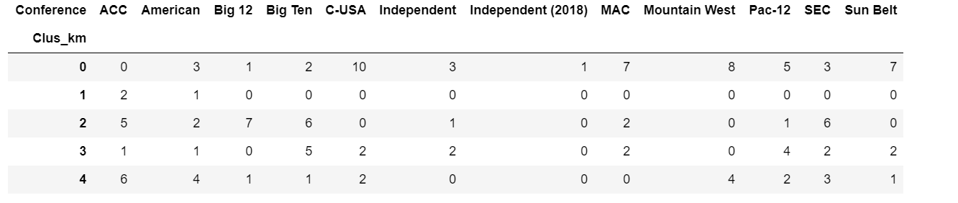
Results
The 5 clusters were labelled:
Small School, Small City, Americana
Nothing nearby (curious)
Hitting bars in Middle America with Big Football
This is OSU’s cluster
Lose the Booze with Mid-level football in large cities
Big City with more modern, hipster tastes

Slide 7
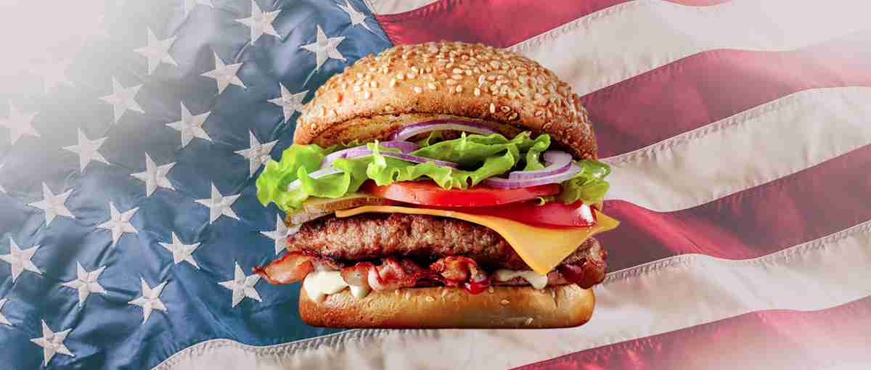
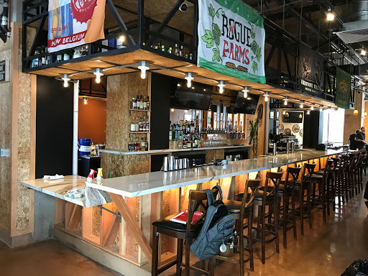
Discussion
Cluster tastes and nuances
Small population with simple American tastes (Fast Food and Pizza)
Only 3 schools with few venues listed nearby
Powerhouse football with a lot of bars and American cuisine.
Power 5 schools at a lower tier with less focus on bars.
Eclectic tastes in huge cities. More of a presence out west.

Slide 8
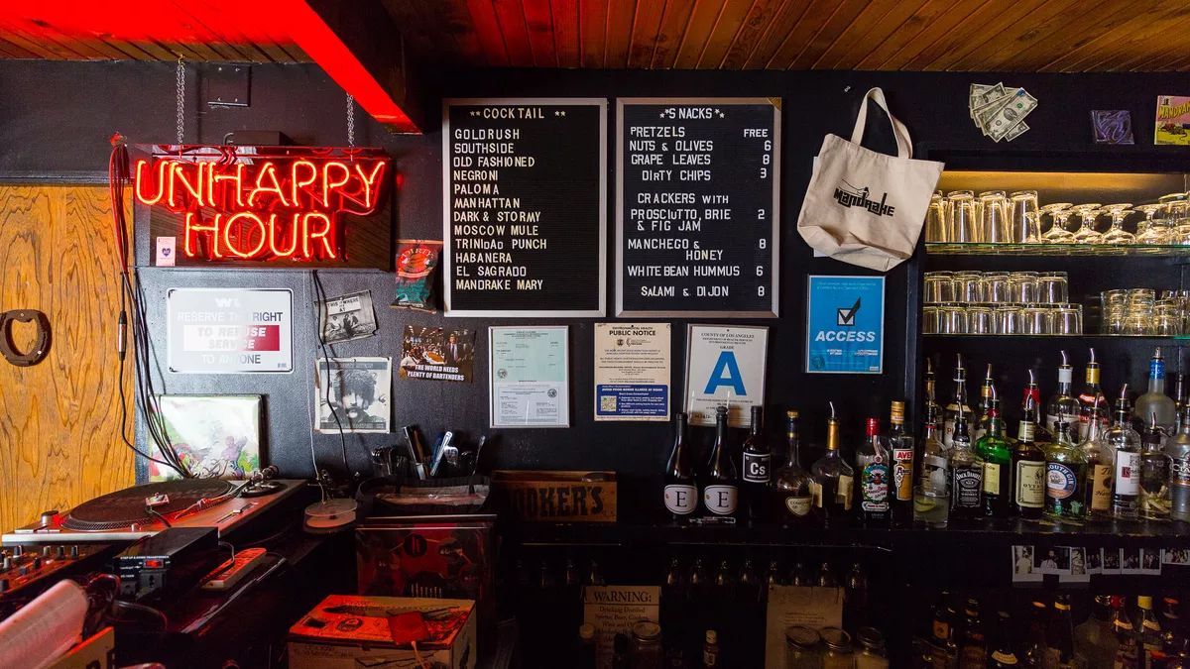
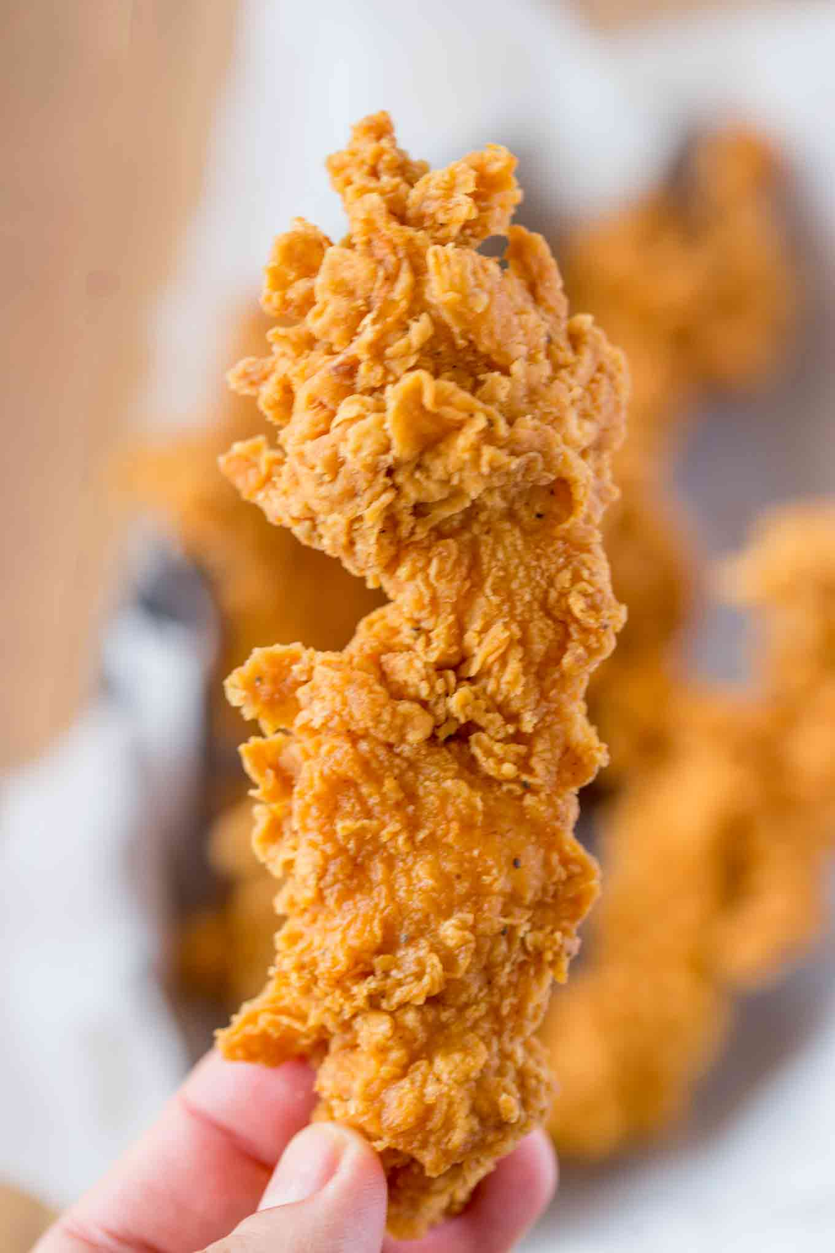
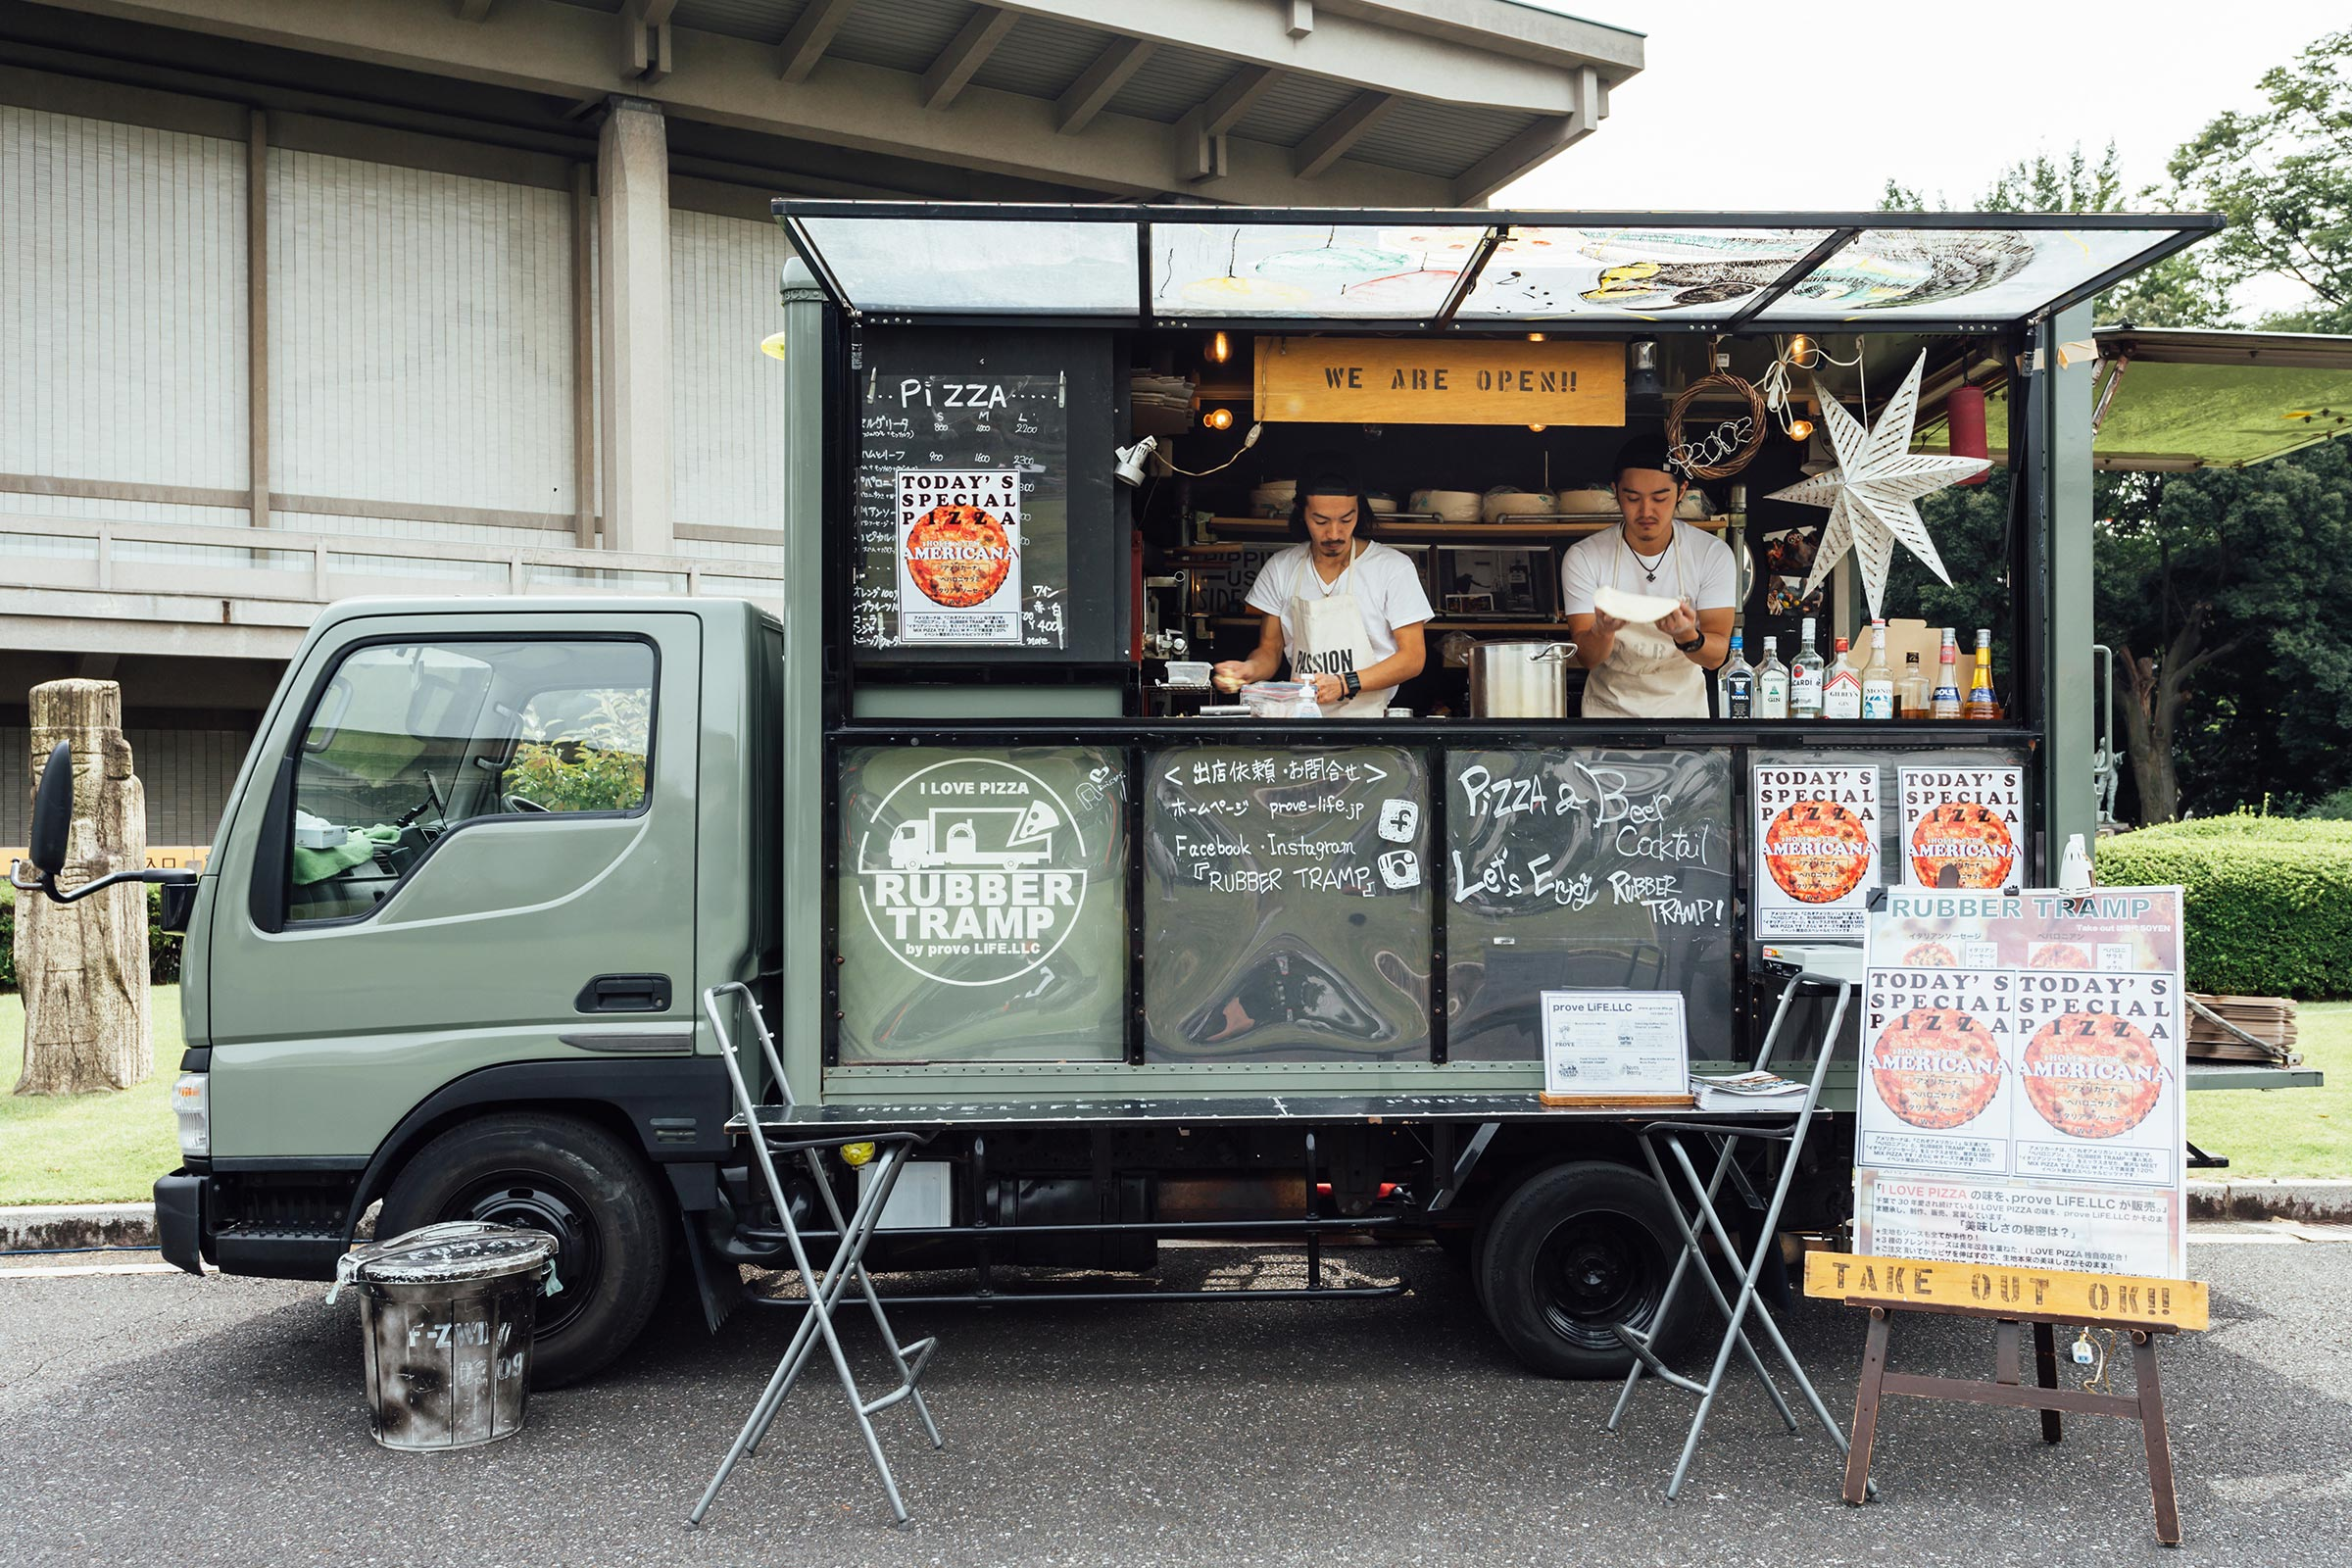
Conclusion
Comparing OSU to its cluster, we find:
An overabundance of bars, burgers, and pizza
A lack of American cuisine and food trucks
Recommendation
Stay out of the bars
Look into fast-food, non-burger American cuisine
Food trucks are enticing

